Slide 1

Lady Brabourne College
Used Car Price Prediction
Presented By
Guided By
Chetana Das
Dr. Moutushi Chatterjee
CU Roll No - 193031-11-0178
CU Reg No - 031-1214-0408-19
Department Of Statistics
14th july 2022

Slide 2
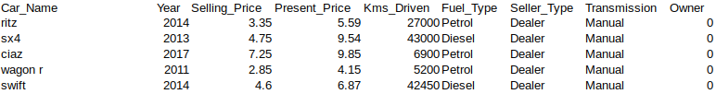
BASIC MOTIVATION
In this project, we will be predicting the prices of used cars. The price of a car depends on a lot of factors like the brand of the car, features of the car, and the fuel it gives and many more.Car price prediction is one of the major research areas in machine learning and statistics. So i want to learn how to train a car price prediction model.Which variables are significant in predicting the price of a car. How well those variables describe the price of a car .
.
.
DATASET:
https://www.kaggle.com/datasets/nehalbirla/vehicle-dataset-from-cardekho. The dataset is a Quantitative and secondary data which is used in this project.
The data set consists of 301 rows and 9 columns.There are 4 numeric columns and 5 categorical columns. Several data set has been created and rearranged by placing individual car model. selling price and present Price‘ column/feature are going to be the target column or dependent feature for this project. This project has been done completely using R programming and Microsoft excel.
PROCESS
I use the methodology are 1)Pie chart 2)Covariance matrix,3) Correlation matrix,4) Multiple linear regression 5)Simple linear regression 6)logistic regression7)Multiple column diagram ,8) A multiple line graph 9)Forecasting 10)Auto plot 11)residual plot 12)box plot, 13)bar diagram
METHODOLOGY

Slide 3
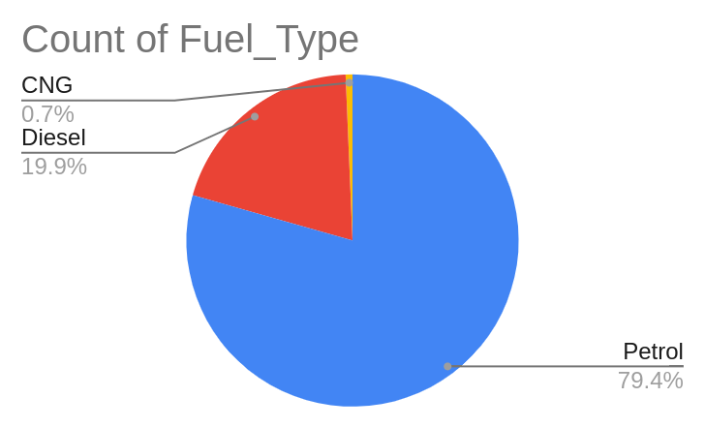
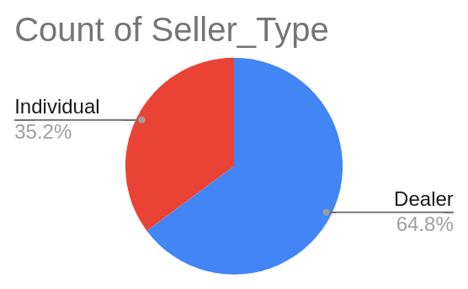
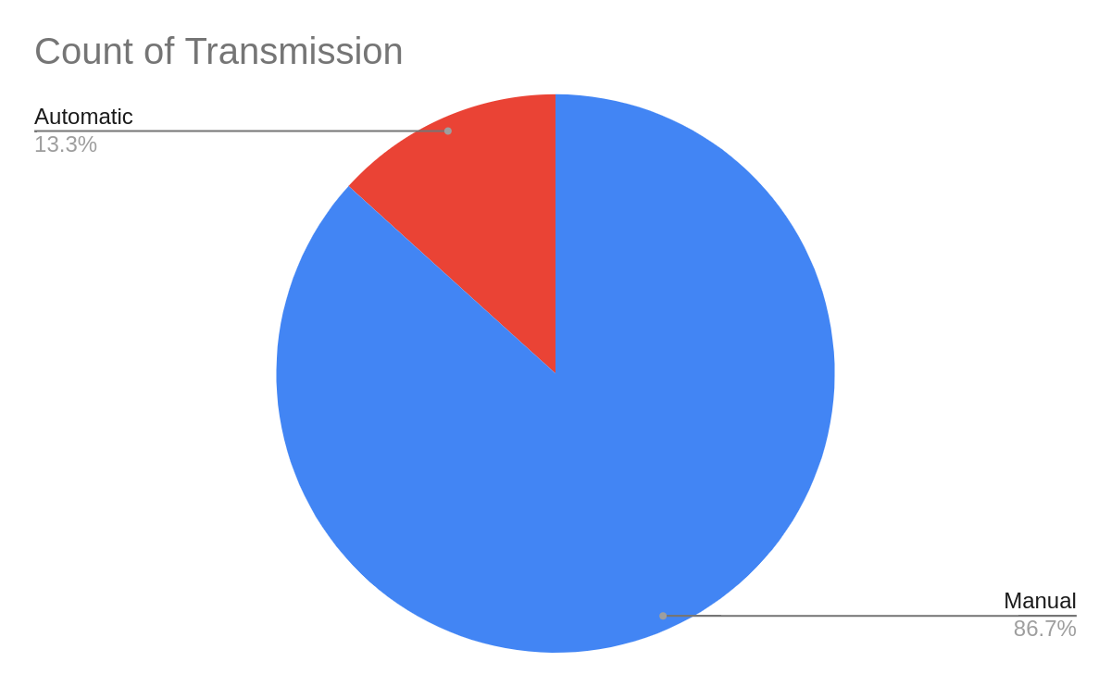
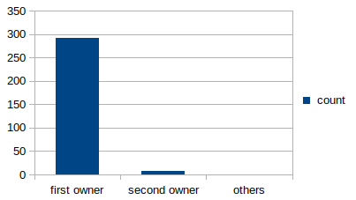
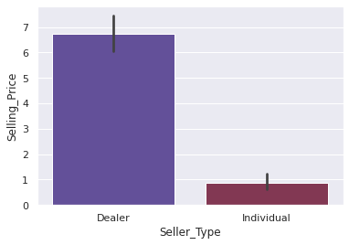
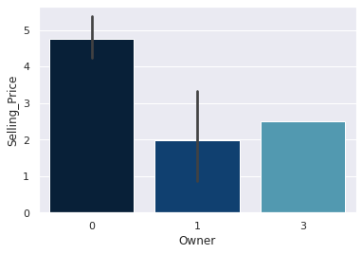
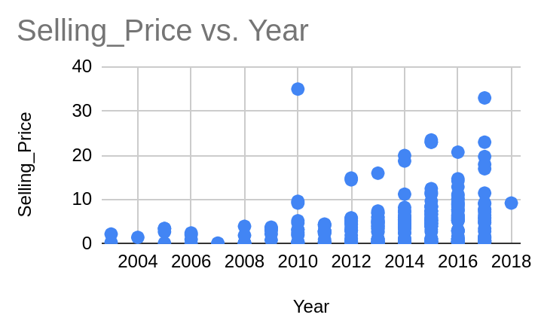
1.Selling_Price the column is filled with the price the owner wants to sell the car at. 2.Year:This column was filled with the year in which the car was bought. 3.Present_Price:This is the current ex-showroom price of the car.

Slide 4
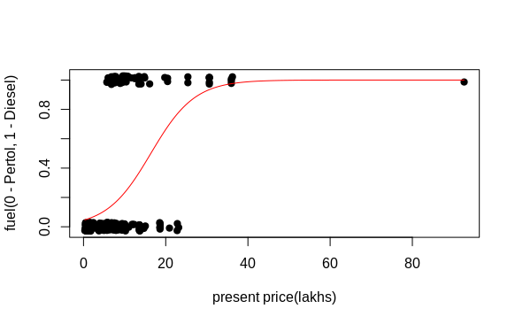
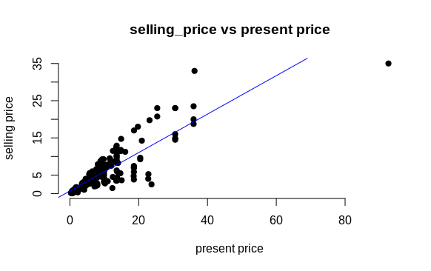
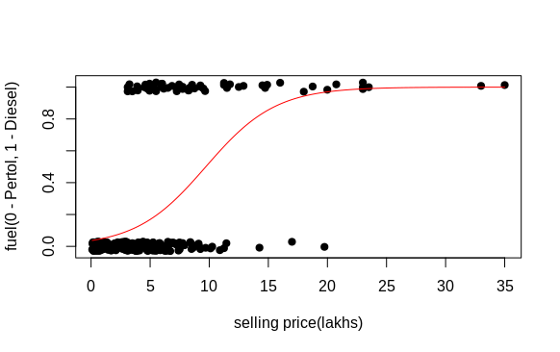
glm(formula = fuelcode ~ presentprice, family = binomial)
fuelcode implies 1 for Diesel ,0 for petrol
Coefficients: Pr(>|z|)
(Intercept) -3.06218 < 2e-16 ***
presentprice 0.18698 4.95e-11
Null deviance: 299.35 on 297 degrees of freedom
Residual deviance: 226.22 on 296 degrees of freedom
AIC: 230.22
glm(formula = fuelcode ~ sellprice, family = binomial)
Coefficients: Pr(>|z|)
(Intercept) -3.28578 < 2e-16 ***
sellprice 0.33839 1.61e-11 ***
Null deviance: 299.35 on 297 degrees of freedom
Residual deviance: 211.31 on 296 degrees of freedom
AIC: 215.31
lm(formula = selling price ~ present price, data = car.data)
(Intercept) present price
0.7185 0.5168
This output indicates that the fitted value is given by y =.7185 + .5168x Residual standard error: 2.428 on 299 degrees of freedom Multiple R-squared: 0.7726, Adjusted R-squared: 0.7718 , p-value: < 2.2e-16
glm(formula = fuelcode ~ car.data.logist$Present_Price + car.data.logist$Selling_Price +
car.data.logist$Kms_Driven, family = binomial, data = car.data.logist)
Null deviance: 299.35 on 297 degrees of freedom
Residual deviance: 200.43 on 294 degrees of freedom
AIC: 208.43

Slide 5
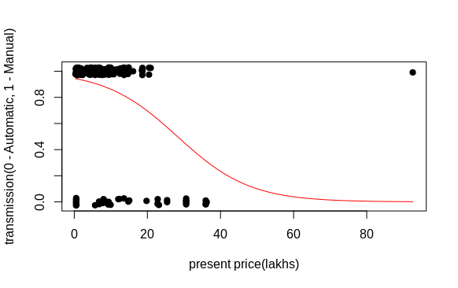
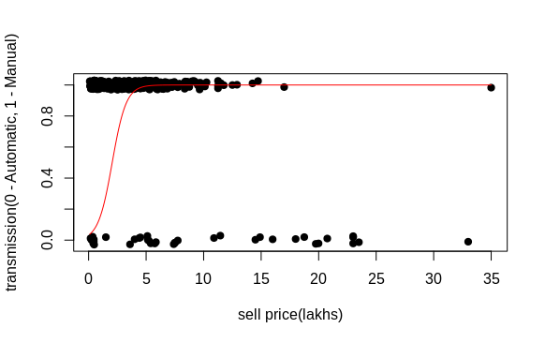
glm(formula = transmissioncode ~ presentprice, family = binomial)
Coefficients: Pr(>|z|)
(Intercept) 2.84020 < 2e-16
presentprice -0.10063 2.29e-06
Null deviance: 231.27 on 297 degrees of freedom
Residual deviance: 204.15 on 296 degrees offreedom
AIC: 208.15
lm(formula = Selling_Price ~ Year + Present_Price + Kms_Driven,
data = car.data)
y= -9.685e+02 + 4. 813e-01x+ 5.256e-01x2 – 1.214e-06x3
Residual standard error: 1.978 on 297 degrees of freedom
Multiple R-squared: 0.8501, Adjusted R-squared: 0.8486
p-value: < 2.2e-16
call:glm(formula = transmissioncode ~ sellprice, family = binomial)
Coefficients :Pr(>|z|)
(Intercept) 2.87374 < 2e-16
sellprice -0.16338 3.72e-07
Null deviance: 231.27 on 297 degrees of freedom
Residual deviance: 199.83 on 296 degrees of freedom
AIC: 203.83
glm(formula = transmissioncode ~ car.data.logist$Selling_Price + car.data.logist$Present_Price
+ car.data.logist$Kms_Driven, family = binomial, data = car.data.logist)
Null deviance: 231.27 on 297 degrees of freedom
Residual deviance: 194.80 on 294 degrees of freedom
AIC: 202.8

Slide 6
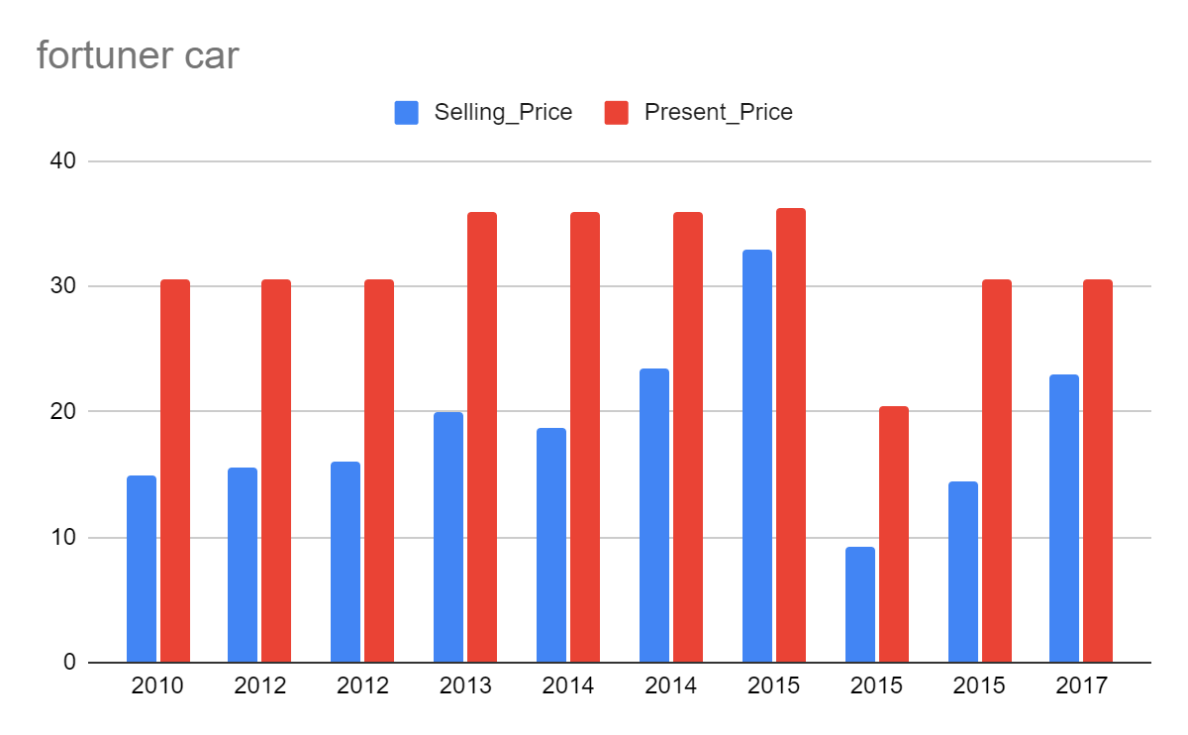
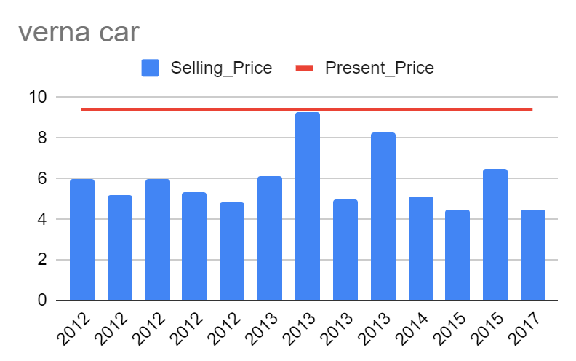
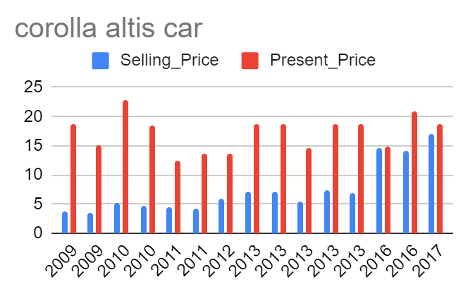
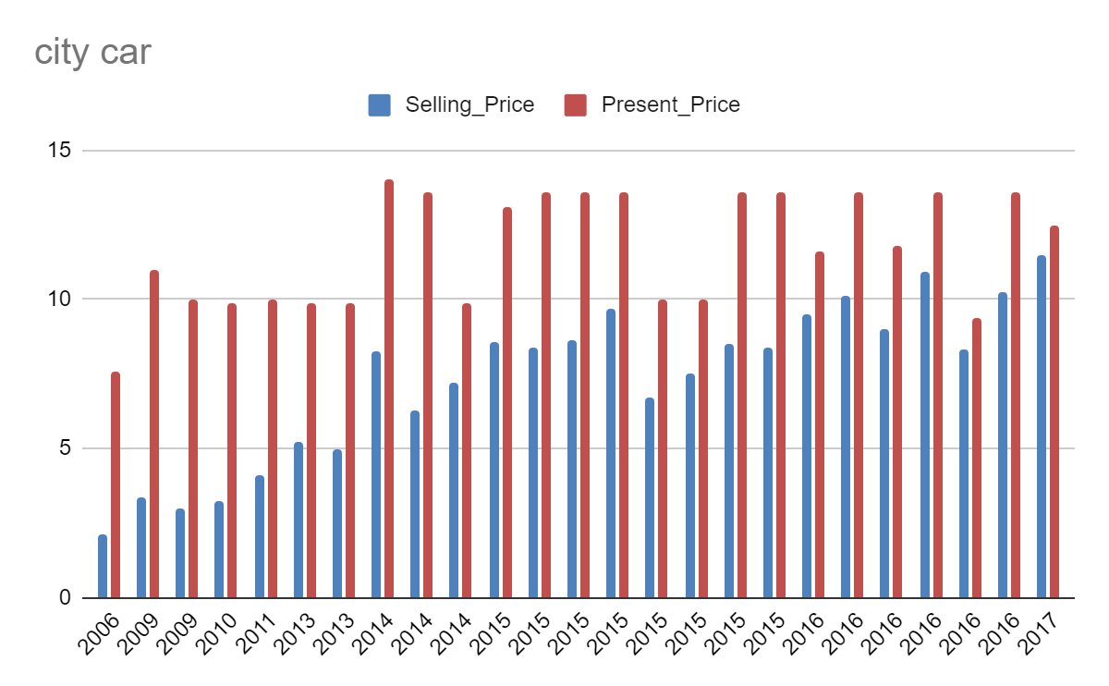
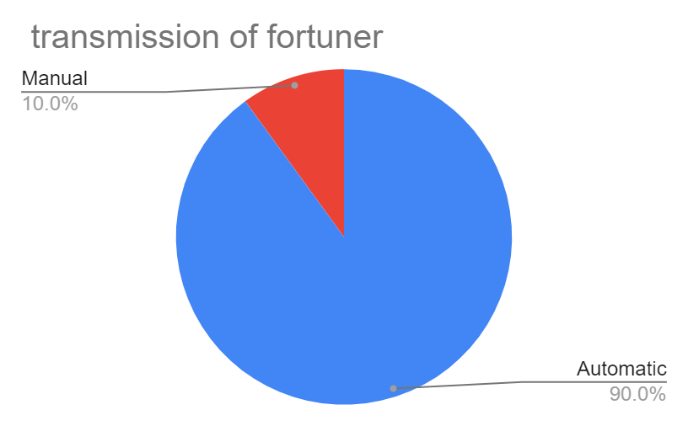
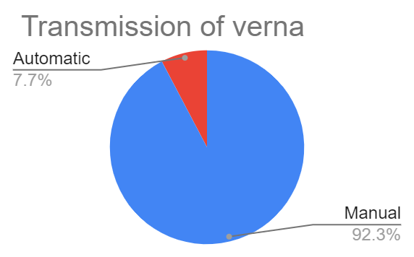

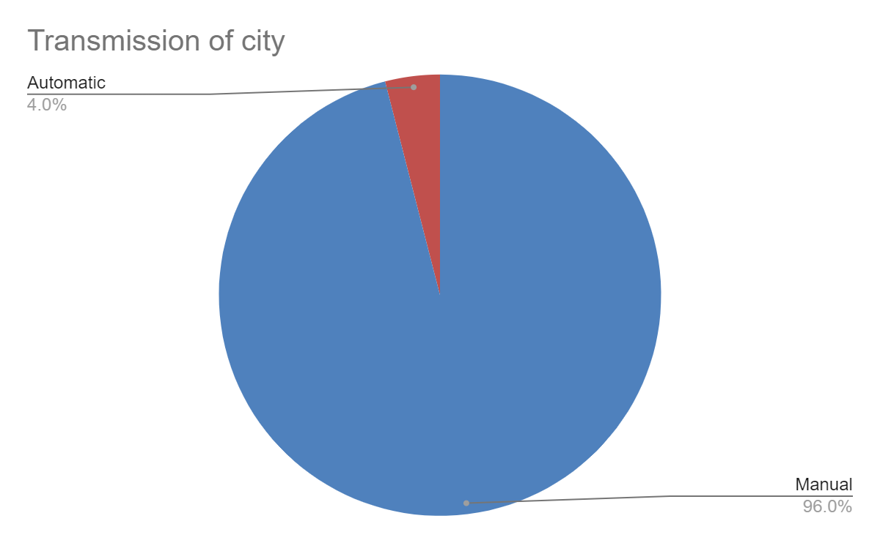

Slide 7
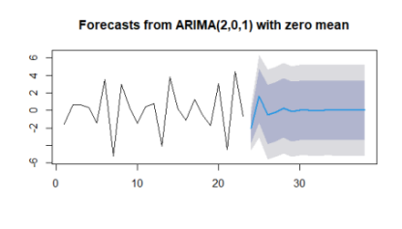
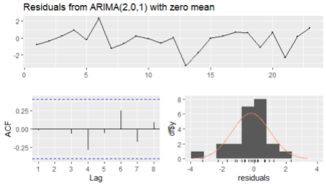
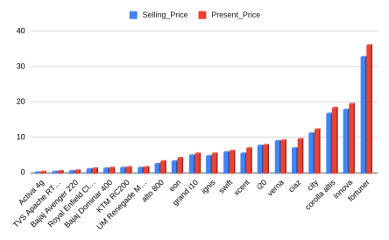
Augmented Dickey-Fuller Test
Dickey-Fuller = -1.6897, Lag order = 2, p-value = 0.6906
Alternativehypothesis: stationary
data: dsell_p
Dickey-Fuller = -4.0633, Lag order = 2, p-value = 0.02105
alternative hypothesis:stationary
now the p value becomes less than .05. so the dara is stationary
Augmented Dickey-Fuller Test
data: dsell_price
Dickey-Fuller = -2.7343, Lag order = 2, p-value = 0.2926
alternativehypothesis: stationary
Ljung-Box test data: Residuals from ARIMA(2,0,1) with zero mean , p-value = 0.1852 Model df: 3. Total lags used: 6

Slide 8
CONCLUSION
It can be observed that Selling Price would be higher for cars that are Automatic
Selling Price of cars seems to have higher prices when sold by Dealers when compared to Individuals.
Selling Price of cars with Fuel Type of Diesel is higher than Petrol and CNG.
Selling Price is high with less Owners used Cars.
The p-value of the model is < 2.2e-16 so the null hypothesis(there is no relationship between selling price and present price) is rejected, this means that coefficients are significant .
Over all, we can conclude that the model is fitting the data satisfactorily.
The coefficients of year and present are very significant to the model,model.Residual Standard Error is 1.978 on 297 degrees of freedom which is small which implies the actual values
of the dataset is close to the predicted values. Adjusted R2value is 0.8486 which means 84.86% variation of selling price can be explained by the model. The p-value of the model is < 2.2e-16.so the null hypothesis is rejected.
.

Slide 9
Thank You

